Slide 1
Using the MBA Learning Center –
YOU have FREE access!
Tammy Cyrus
Director of Professional Development
MBA Research & Curriculum Center

Slide 2
SESSION GOALS
Accessing the MBA Learning Center
Developing a Course
Adding the Teacher Role
Retrieving Content from the Commons
Notes:
The goals for today’s session is accessing the Learning Center, developing a course inside of the Learning Center, adding the teacher role, retrieving content from the commons folder, and adding students.

Slide 3
WHAT IS THE LEARNING CENTER?
An interactive, digital database used for teaching business administration courses
Uses a Canvas platform
Houses our Learning Activity Packages (LAPs)
Provides access to our test item bank
Includes 100% standards-aligned content
Notes:
The MBA Learning Center is an interactive, digital database used for teaching business administration courses. Canvas is the platform that is used for the Learning Center. The learning center houses all of our Learning Activity Packages, also known as LAPs and provides access to our test item bank. The test item bank 100% aligns with the national standards.

Slide 4
Learning Center Subscription
Annual subscription per school for 5 teachers at that school
Access to 300+ resources including Learning Activity Packages (LAPs)
Choose Your Method
  Build your courses within the MBA Learning Center
  Utilize the ready-made Learning Center Course Guides
Notes:
The MBA Learning Center subscription is an annual subscription that is set up per school for up to five teachers at that school. This subscription gives you access to over 300 instructional resources including Learning Activity Packages (LAPs), our test item bank, engaging activities, projects, videos, articles, and more. You can create a shell and build your course within the MBA Learning Center and also bring your students into the Learning Center with you to give them engaging and interactive experience within your classroom.
We are currently working to restructure our course content in the Learning Center by Developing Learning Center Course Guides. These course guides will be available this fall.
Thanks to the Nebraska Department of Education, you have free access to the MBA Learning Center.

Slide 5
Where to Start
Missouri is an Enhanced Membership State
  You have FREE access to the Learning Center – thanks to the Missouri Department of Education
  Access to additional resources in the State’s Connection portal
  Discount on additional products
Send the following information to helpme@mbaresearch.org
        Your name
        Email address (school-issued email required)
        School Name
        School Address
        City, State, Zip
Notes:
If you have not already signed up for The Learning Center, you will need to do that before you can access it. Here is the information that MBA Research needs from you in order to create an account for the Learning Center. If you have not obtained an account at this point, send your name, email address (school email address required), school name, school address, city, state and zip to helpme@mbaresearch.org. The normal turn around time is a couple of days.

Slide 6
The Learning Center
https://mba.instructure.com/
Notes:
To access The Learning Center, go to mba.instructure.com. You can also access the Learning Center through mbaresearch.org’s website and State’s Connection.

Slide 7
STEP 1 – CREATE AN EMPTY COURSE

Slide 8
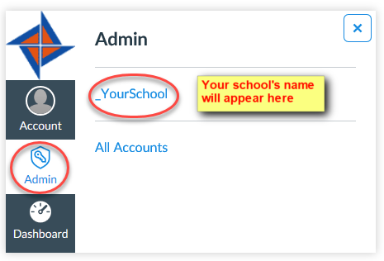
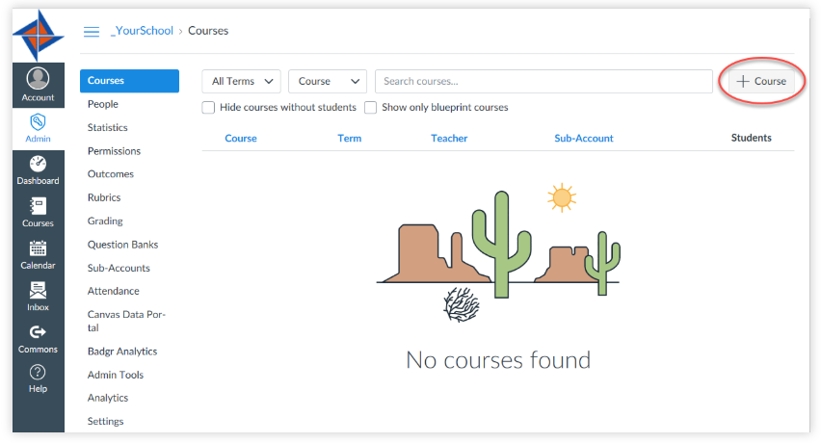
STEP 1 – CREATE AN EMPTY COURSE
Select admin
Select your school
3. Select + course
Notes:
After you have created your account for the MBA Learning Center, the first step that you will need to do is to create an empty course. You have to have a place to put your content, whether you import content from the commons folder or whether you upload information for your course, you have to create a place to store it. This place is an empty course.
The gray navigation menu is the global navigation menu – it is always seen on your screen regardless of where you are in the learning center.
To create a course, you will choose admin from the global navigation menu, then select your school name account. From there you will select + course located on the right side of your screen.

Slide 9
STEP 2 – NAME YOUR COURSE

Slide 10
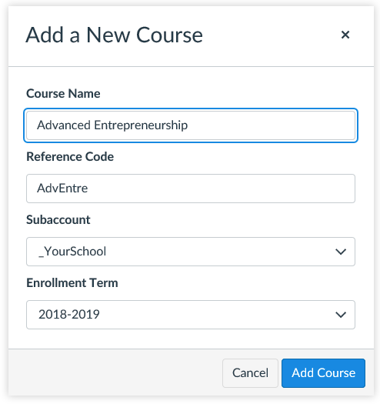
STEP 2 – NAME YOUR COURSE
Name your Course
Provide a Code (you make it up)
Enrollment Term – recommended to use the current school year – do not use default term
Select Add Course
Notes:
Once you select +course, a dialog box will display for you to name your course. This is step 2.
You will create your course name, provide a code (which is something you will make up), and select the current school year. It is not recommended to select default term.

Slide 11
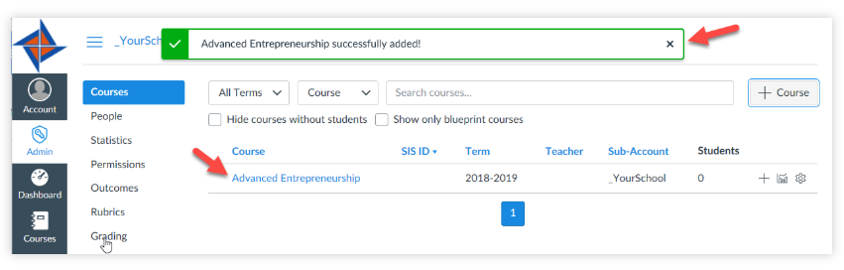
Confirmation that the course was added!
Notes:
Select courses and you should see a green box letting you know that the course was successfully added.
Once you create your course shell, you will notice an additional navigation menu appears beside the global navigation menu. This is the course navigation menu and appears anytime that you are inside of a course.

Slide 12
STEP 3 – ENROLL YOURSELF

Slide 13
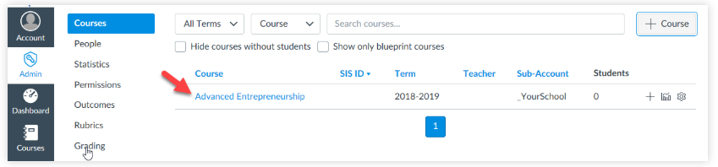
STEP 3 – ENROLL YOURSELF
Canvas will not allow you to import content into a course until you add a teacher (you!) to the course.
Go to Courses
Locate the course and click the blue-linked course name to open the course.
Notes:
In order to begin building your course, you must make yourself the teacher of the course. Go to your list of courses, locate the course that you need to add yourself to, and and click on the blue linked course name to open the course.

Slide 14
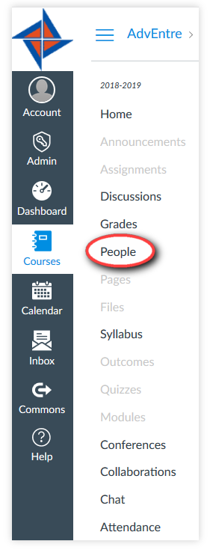
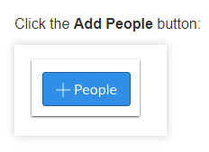
STEP 3 – ENROLL YOURSELF
Select people
Notes:
Once you are inside of the course, click on people located on the navigation menu and click on the +people button located on the right side of your screen.

Slide 15
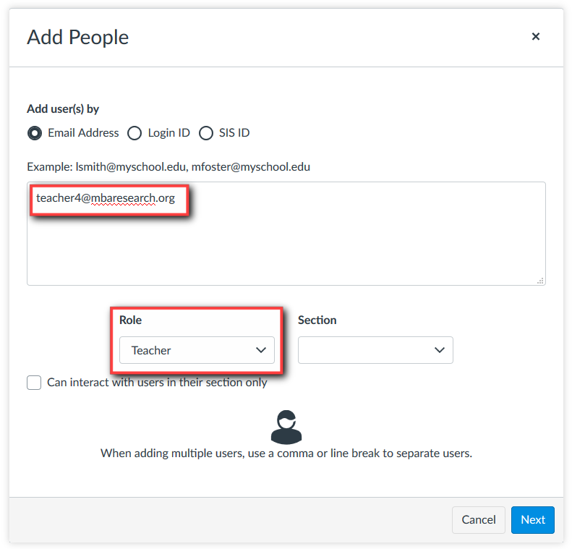
STEP 3 – ENROLL YOURSELF
Add your email address
Select teacher as role
Select Next
Notes:
From here you will add your email address and select teacher as your role. Select next.

Slide 16
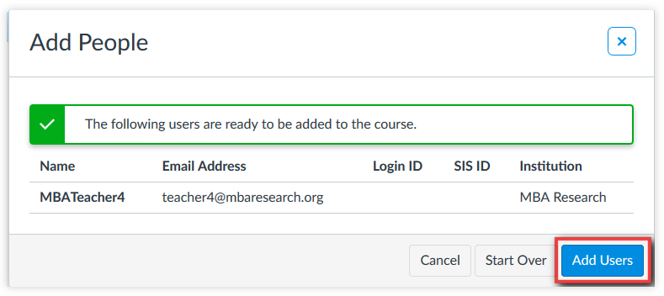
STEP 3 – ENROLL YOURSELF
Select Add Users
Notes:
If you are registered in the MBA Learning Center, your name and email information will be listed. Select Add Users.

Slide 17
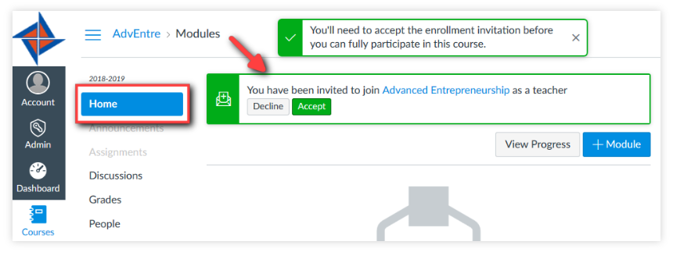
Accept invitation to the course
On the homepage of the course, you will receive an invitation to join the course. You must accept to join.
Notes:
After you have added yourself, an invitation will be sent to you to accept. Staying within your course, choose home, and you should see the invitation to join the course. Once you accept the invitation, you will be able to build your course.

Slide 18
STEP 4 – ADD CONTENT TO YOUR COURSE
LAPs  Learning Center Course Guide

Slide 19
What are LAPs?
Learning Activity Packages (aka Leadership, Attitude, Performance Modules)
Research-based and align with national standards for marketing, management, finance, and business administration
Provide relevant information on the topic
Target audience = high school students
Several components of a LAP that can be used
All components do not have to be used to be effective
Notes:
What are LAPs and why use them?
LAPs are one of the major resources that MBA Research and Curriculum Center provide for teachers. LAPs is the acronym for Leadership, Attitude, Performance Modules.
LAPs are research-based and align with national standards for marketing, management, finance and business administration
They provide relevant information to the topic.
LAP writers identify the target audience as high school students
Include numerous components that include a reading guide, knowledge questions, group and individual activities, PowerPoint presentation, Instruction Guide, assessments
Many teacher do not realize that all of the components of a LAP Module do not have to be used to be effective

Slide 20
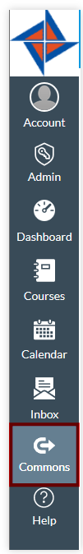
STEP 4 – ADD CONTENT TO YOUR COURSE
MBA Learning Center Canvas DOES NOT communicate with your school district’s Canvas.
You cannot access MBA Learning Center’s Commons from your school district’s Canvas.
Add LAPs to your course by selecting Commons in the MBA Learning Center.
Notes:
MBA Learning Center Canvas DOES NOT communicate with your school district’s Canvas.
You cannot access MBA Learning Center’s Commons from your school district’s Canvas.
Add LAPs to your course by selecting Commons in the MBA Learning Center.
If you are able to retrieve LAPs from your school Canvas account, please note that they were not placed there by MBA Research and the LAP information may be out of date.

Slide 21
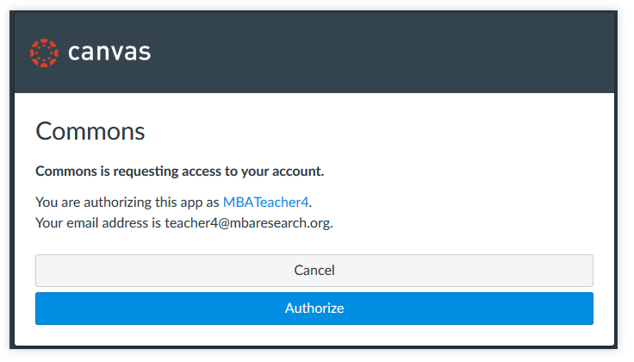
STEP 4 – ADD CONTENT TO YOUR COURSE
If this is the first time you have accessed the MBA Learning Center, you will need to authorize it. Click the Authorize button.
Notes:
If this is the first time you have accessed the commons area of the MBA Learning Center, you will need to authorize the Commons database having access to your account it. Click the Authorize button.

Slide 22
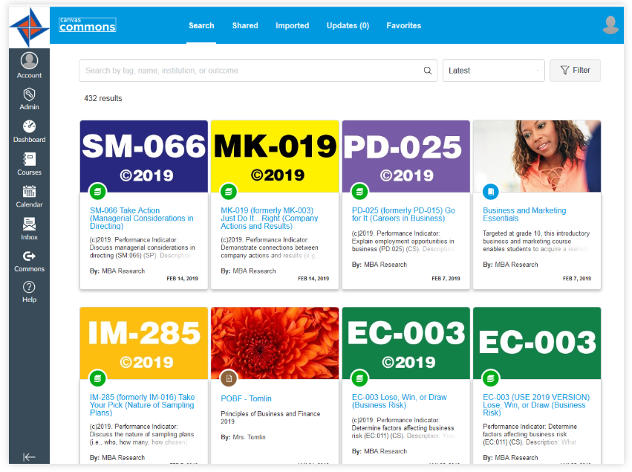
STEP 4 – ADD CONTENT TO YOUR COURSE
There are different ways to search for LAPs:
By LAP number (BL-001)
By LAP name
By keyword or subject area
Notes:
Course guides identify which performance indicators have LAPs available. The information provided in determining whether a performance indicator has a LAP includes the word LAP followed by the instructional area and number. The LAP name should also be a part of the course material that you are reviewing. When searching for LAPs, include either the LAP number (use a hyphen between the instructional area abbreviation and the database number or by LAP name, keywords, or subject areas.

Slide 23
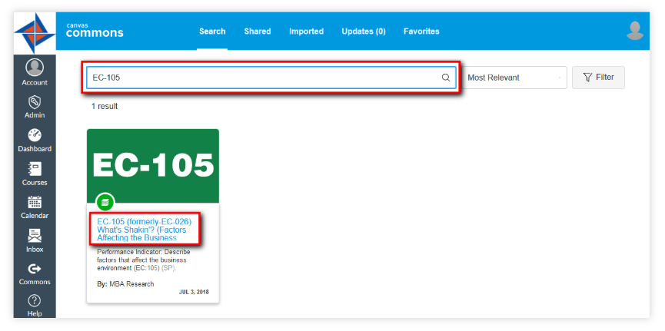
STEP 4 – ADD CONTENT TO YOUR COURSE
Once LAP is located, click the resource title (LAP name) to preview the contents and import the LAP.
Notes:
Once the LAP is located, click the resource title (LAP name) to preview the contents and import the LAP.

Slide 24
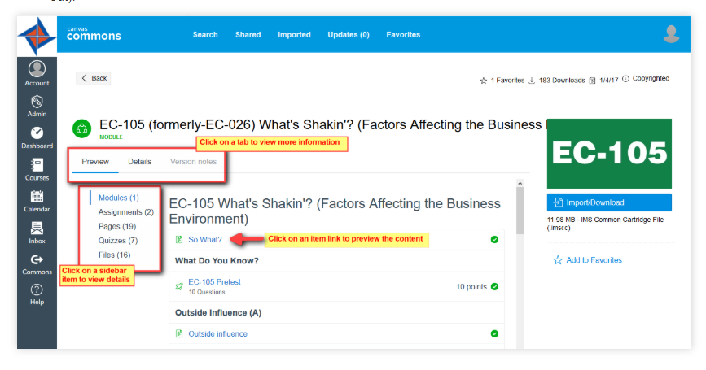
STEP 4 – ADD CONTENT TO YOUR COURSE
The Preview tab allows you to see the contents of the LAP before importing.
Details tab provides a description of the LAP.
Version Notes tab gives a history of updates made to the LAP.
If the version notes tab is grayed out, there are no updates.
Notes:
The preview allows you to see the contents of the LAP before importing.
The details tab provides a description of the LAP.
The version notes tab gives a history of updates made to the LAP. If the version notes tab is grayed out, there are no updates.

Slide 25
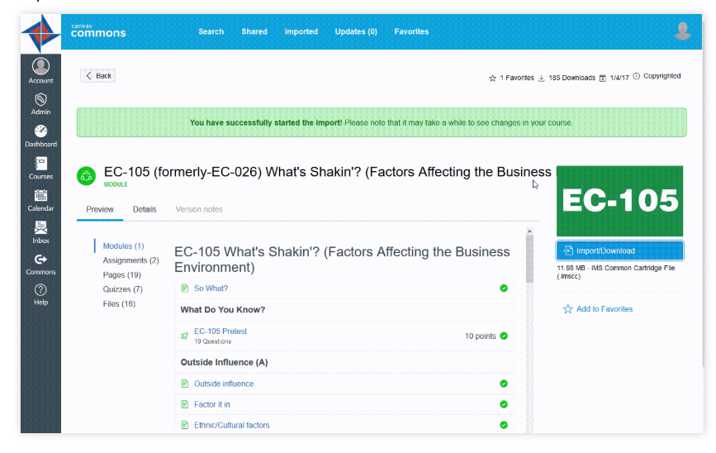
STEP 4 – ADD CONTENT TO YOUR COURSE
When you are ready to import the content, click the import/download button.
Select the course that the LAP will be imported into
Select Import into Course
A message will appear that the import has started
Notes:
When you are ready to import the content, click the import/download button.
Select the course that the LAP will be imported into
Select Import into Course
A message will appear that the import has started

Slide 26
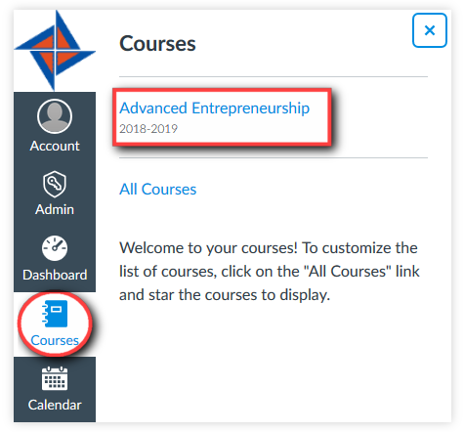
STEP 4 – ADD CONTENT TO YOUR COURSE
Select courses from the left-hand menu and locate your course
Notes:
Select courses from the left hand menu and locate your course

Slide 27
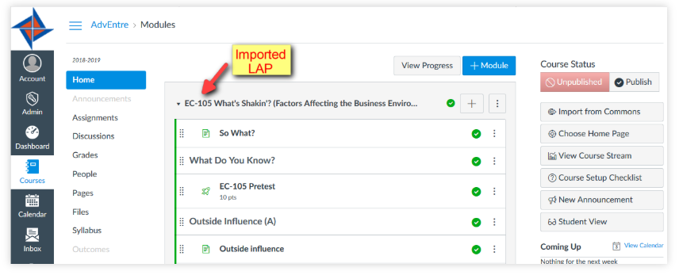
STEP 4 – ADD CONTENT TO YOUR COURSE
LAPS appear in the Modules section of the course
Import status link will be available at the top of the page until the import is complete
Notes:
LAPs appear in the Modules section of the course, broken down into several manageable sections.

Slide 28
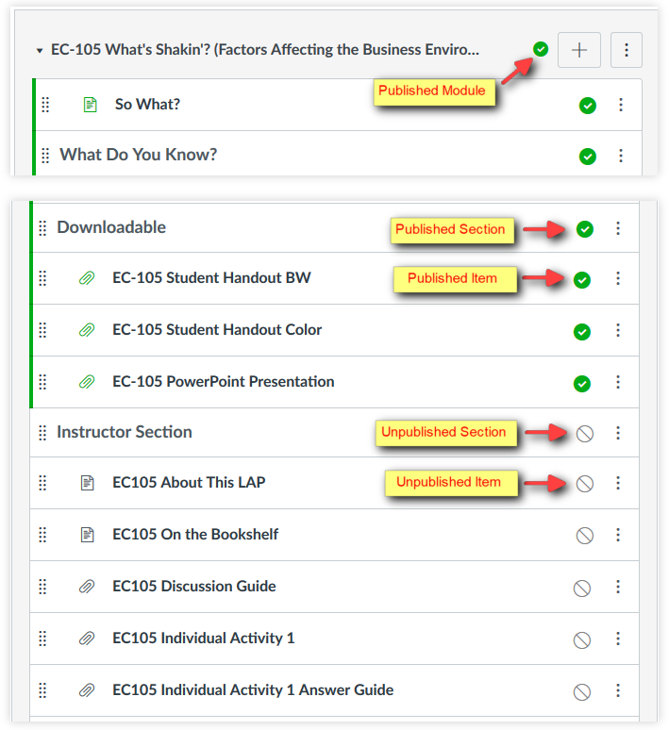
WORKING
WITH MODULES
All LAPs are modules
Sections and items in green are published (students can see and access the content)
Sections in gray are unpublished (not visible to students)
By default, the LAP and its contents come in the course as published (excludes the Instructor Section)
Notes:
Some important things to note:
All LAPs are modules
Sections and items in green are published (students can see and access the content)
Sections in gray are unpublished (not visible to students)
By default, the LAP and its contents come in the course as published (excludes the Instructor Section)

Slide 29
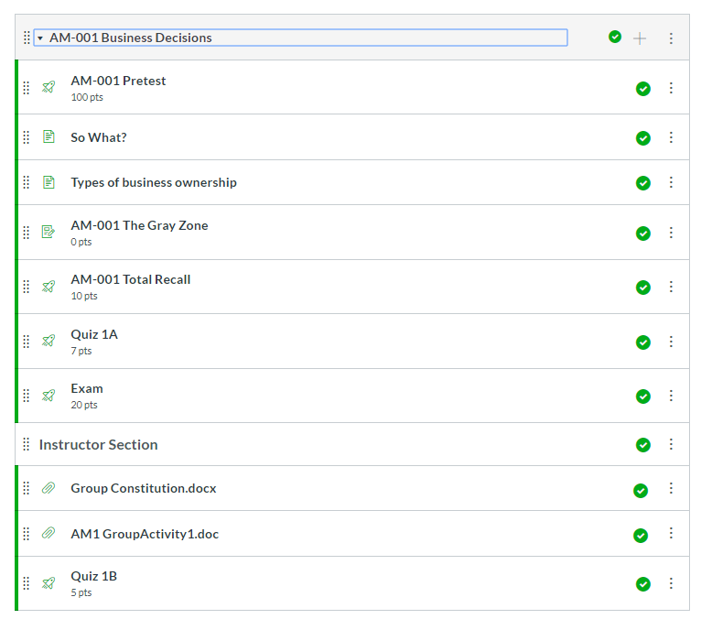
WORKING WITH MODULES
Note of Caution!!
If you unpublish a module then republish it, all components of the module are published – including the instructor section. You have to unpublish each item in the module individually!
Notes:
Just a note of Caution!!
If you unpublish a module then republish it, all components of the module are published – including the instructor section. You have to unpublish each item in the module individually to prevent students from seeing items that you do not want them to see!

Slide 30
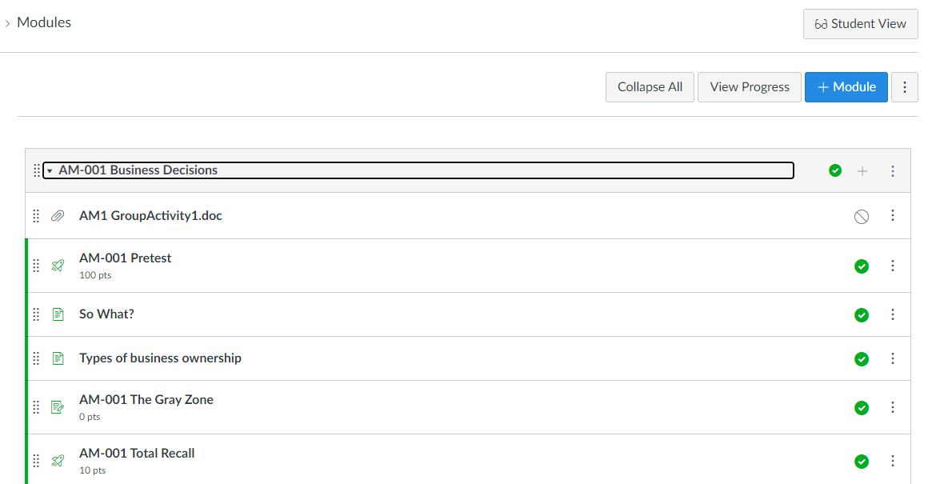
WORKING WITH MODULES
You can always see what the student view looks like by selecting Student View from the menu!
Notes:
If you wonder what the student’s can see, you have the ability to view the page as a student!
While inside of the course, select Student View from the menu on the right side of the screen. This provides an extra level of assurance of what students can see and have access to.

Slide 31
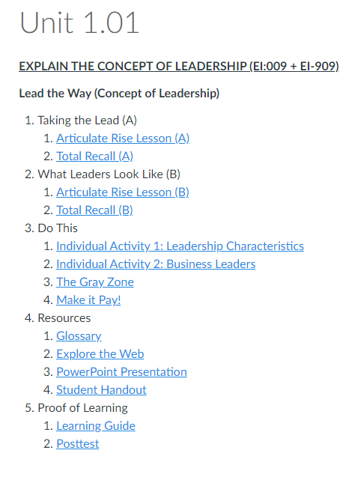
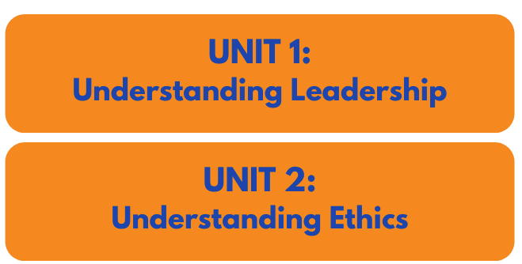
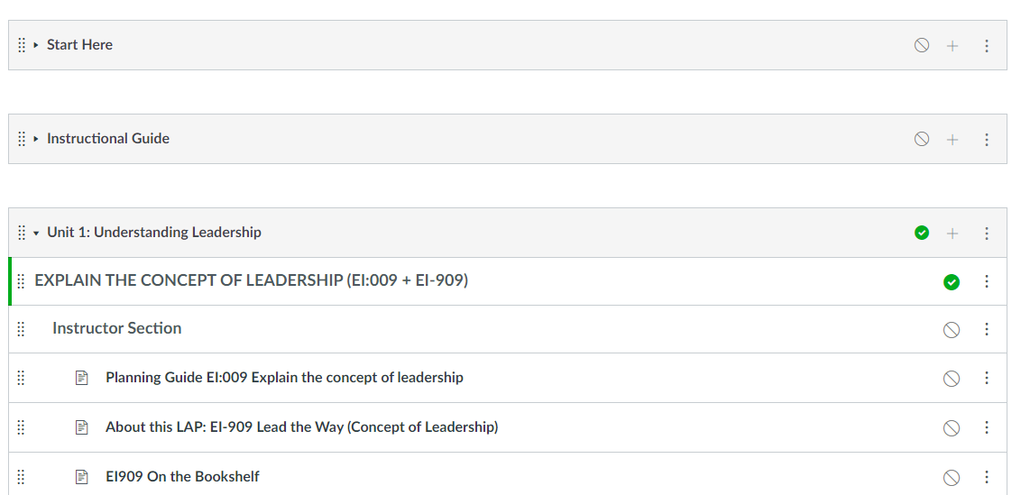
LEARNING CENTER COURSE GUIDES
Teacher modules
Student pages
Ready made course content
Sequence of instruction
Interactive activities
Notes:
An additional option for using curriculum material in the Learning Center is by importing the ready-made Learning Center Course Guide. This option populates your course shell with the entire course. Ideally, the LCCG is designed to bring students into the Learning Center with you. Students access assignments through pages and action buttons while teacher content is available in modules The same steps are used to import the LCCG into your shell as with importing LAPs. The process to import takes a little longer because the entire course is added to your course shell.

Slide 32
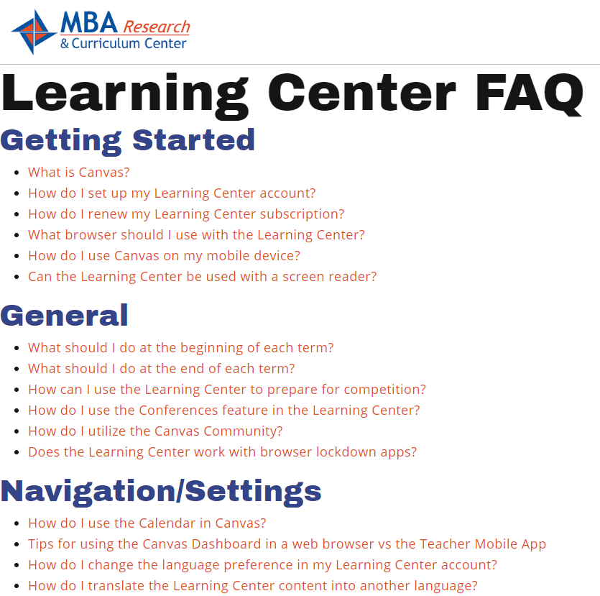
Need Help with The Learning Center?
Visit the FAQ section on the Learning Center
  Go to mbaresearch.org
  Select Online Learning Center under Teachers and Local Administrators
  Locate and Select Learning Center FAQ
Notes:
If you need help with the learning center, you can visit our FAQ section on the Learning Center. To access that, go to mbaresearch.org, and select Online Learning Center under Teachers and Local Administrators. Scroll down to locate the Learning Center FAQ. Select that option and you will see a list of resources broken down by topics to assist you with learning more about the Learning Center.

Slide 33



Connect With Us!
Twitter.com/MBAResearchNews
Website – www.MBAResearch.org
Phone – 614.486.6708 800.448.0398
Customer Service – Service@MBAResearch.org
Facebook.com/MBAResearch
Instagram: /MBA_Research
LinkedIn: /company/MBA-Research-&-Curriculum-Center
Notes:
You can stay connected to us by following us on social media. I would encourage you to take a look at our website as there are other resources that you may find beneficial. If you have any questions on any of our resources, you can call the office or email service@MBAresearch.org and someone will be happy to assist you.

Slide 34

QUESTIONS?
Email helpme@mbaresearch.org or
Tammy Cyrus at cyrust@mbaresearch.org
Notes:
Do you have any questions?

